Slide 1
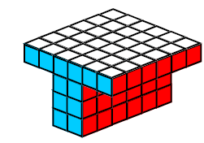
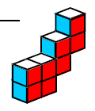
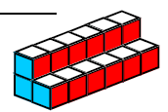
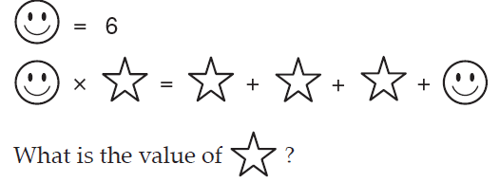
5 Questions
What is the volume of these shapes?
Answer the following
  -6 + + 2 = 3. 4 + - 1 =
  14 - - 3 = 4. -7 - + 4 =
3. Find the mean of;
23, 34, 35, 37, 19
4. What do I mean when I write 5³?
5.

Slide 2
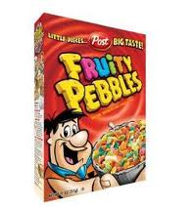
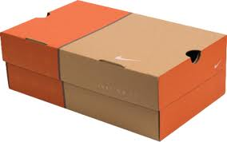

RECTANGULAR PRISM
A RECTANGULAR PRISM, is a solid figure that has six faces that are all rectangles.

Slide 3
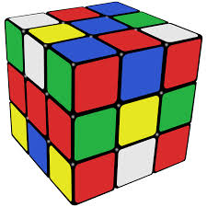
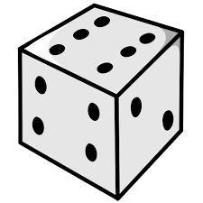
Cube
A CUBE, is a solid figure that has six faces that are all squares. This shape is classified as a rectangular prism because all squares are technically rectangles

Slide 4
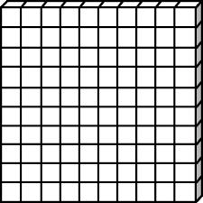
To find the volume of a rectangular prism:
1.
10cm
7cm
10cm

Slide 5
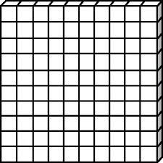
To find the volume of a rectangular prism:
1. Calculate the area of the “face” = 100cm²
2. Multiple that area by how rows it goes back
Area= 10 x 10cm = 100cm²
10cm
7cm
10cm

Slide 6
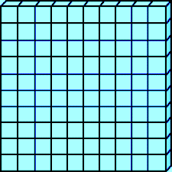
To find the volume of a rectangular prism:
1. Calculate the area of the “face” = 100cm²
2. Multiple that area by how rows it goes back
Volume = 100cm² x 1cm back
= 100cm³
10cm
7cm
10cm

Slide 7
To find the volume of a rectangular prism:
1. Calculate the area of the “face” = 100cm²
2. Multiple that area by how rows it goes back
Volume = 100cm² x 2cm back
= 200cm³
10cm
10cm
7cm
10cm

Slide 8
To find the volume of a rectangular prism:
1. Calculate the area of the “face” = 100cm²
2. Multiple that area by how rows it goes back
Volume = 100cm² x 3cm back
= 300cm³
10cm
7cm
10cm

Slide 9
To find the volume of a rectangular prism:
1. Calculate the area of the “face” = 100cm²
2. Multiple that area by how rows it goes back
Volume = 100cm² x 4cm back
= 400cm³
10cm
7cm
10cm

Slide 10
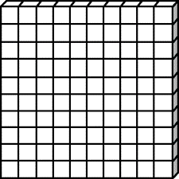
To find the volume of a rectangular prism:
1. Calculate the area of the “face” = 100cm²
2. Multiple that area by how rows it goes back
Volume = 100cm² x 5cm back
= 500cm³
10cm
7cm
10cm

Slide 11
To find the volume of a rectangular prism:
1. Calculate the area of the “face” = 100cm²
2. Multiple that area by how rows it goes back
Volume = 100cm² x 6cm back
= 600cm³
10cm
7cm
10cm

Slide 12
To find the volume of a rectangular prism:
1. Calculate the area of the “face” = 100cm²
2. Multiple that area by how rows it goes back
Volume = 100cm² x 7cm back
= 700cm³
Volume is in units³
10cm
7cm
10cm

Slide 13
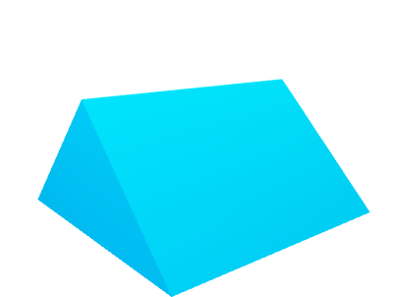
A line is one dimensional. We can only measure it’s length so it’s units are one dimensional units (mm, cm, m, km)
These shapes are 2 dimensional. We can measure it’s length and width so it’s units are two dimensional units (mm², cm², m², km²)
These shapes are 3 dimensional. We can measure it’s length, width and depth so it’s units are 3 dimensional units (mm³, cm³, m³, km³)

Slide 14
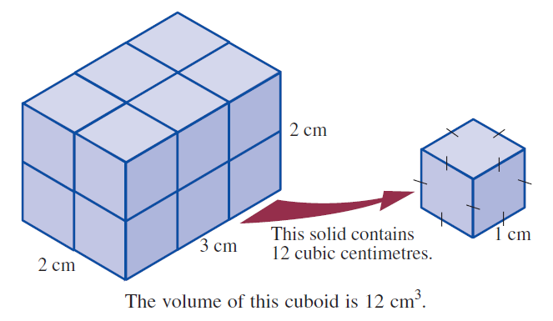
24
7
30
Date
Topic : Volume of Prisms
EQ – How do you find the volume of a prism?
How do I calculate the volume of a rectangular prism?
Volume is the amount of space there is inside a 3d object.
Think of a lunch container and ask yourself how many 1cm cubes could fit inside it. The answer is the volume of the container.
Volume = length x width x height
To find the volume of a prism, find the area of the base and
Multiply it by the depth of the prism

Slide 15
I Do
7m
12m
7cm
7m
4cm
15cm

Slide 16
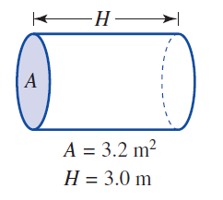
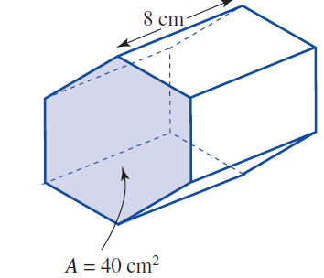
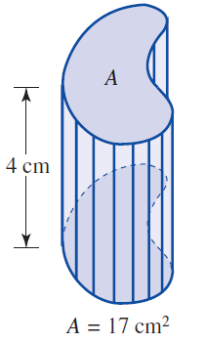
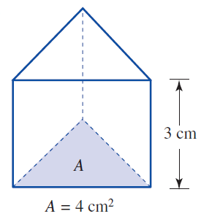

Slide 17
Volume (rectangular prism)
Formula:
V = B x h
V = l x w x h
h
w
l

Slide 18
Find the volume of this prism…
Formula:
V = B x h
V = l x w x h
7 cm
4 cm
5 cm

Slide 19
Find the volume of this prism…
Formula:
V = B x h
V = l x w x h
V = 5cm x 4cm x 7cm
7 cm
4 cm
5 cm

Slide 20
Find the volume of this prism…
Formula:
V = B x h
V = l x w x h
V = 5cm x 4cm x 7cm
V = 140cm³
7 cm
4 cm
5 cm

Slide 21
Does it matter which side is the base?
Formula:
V = B x h
V = l x w x h
V = 7cm x 4cm x 5cm
5 cm
4 cm
7 cm

Slide 22
You Do

